Slide 1


Body Tightening

Slide 2


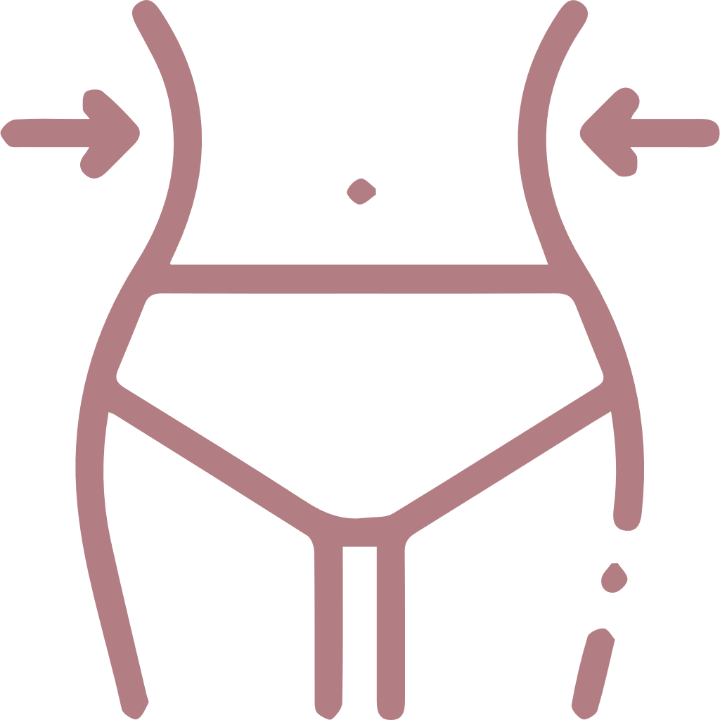






Causes of sagging skin
Bad diet
Aging
Dramatic weight loss
Sun Exposure
Skin is unable to bounce back
Skin inflammation & premature cell damage = sagging
Collagen & Elastin decreases over time
Decreases Collagen & Elastin
Sedentary lifestyle
Smoking
Lack of hydration
Good muscle tone helps to support the skin
Dry skin, wrinkles and lack of skin tone = sagging
No moisture and fluid retention = sagging

Slide 3
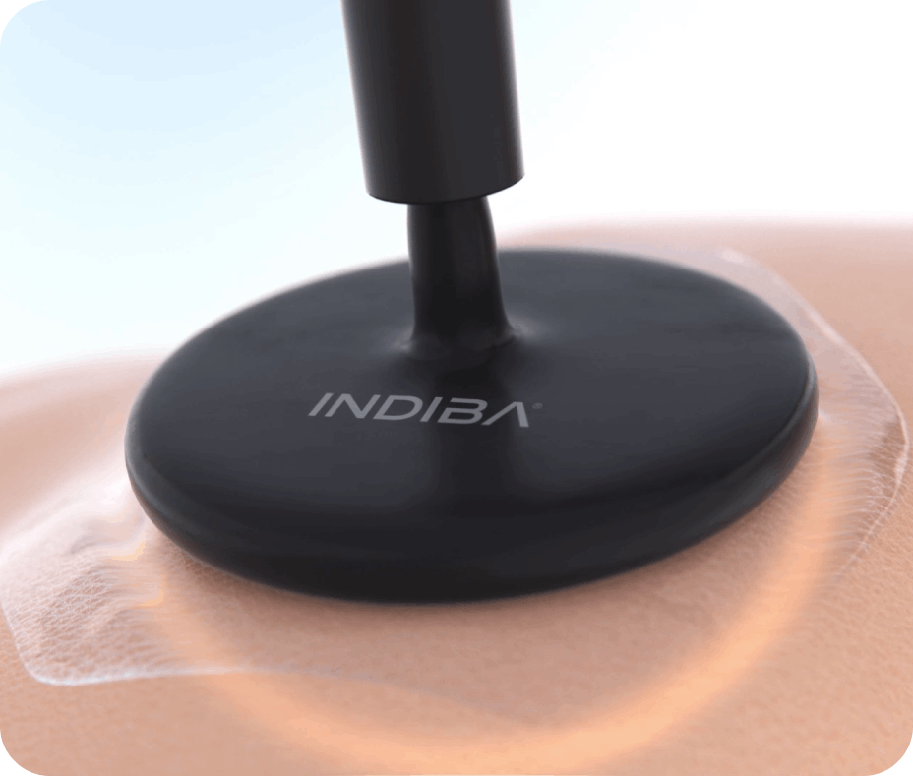


What is INDIBA? Radiofrequency 448 kHz
Radiofrequency is a type of electromagnetic current with beneficial therapeutic effects on the body's tissues. Due to these effects, it is widely used in beauty treatments. ​
448 kHz is the specific frequency at which INDIBA works and the frequency at which benefits are generated at the cellular level, allowing a faster and more efficient tissue recovery.
To better understand what INDIBA does, watch this video:
INDIBA Technology

Slide 4

How will INDIBA’s technology will help you?
The proven INDIBA technology promotes healthy cell function and revitalization through radiofrequency. INDIBA works at a specific frequency of 448 kHz, which produces thermal and subthermal effects to achieve results from the first session.
The patented Proionic® System uses capacitive-resistive (CAP-RES) technology to biostimulate, vascularize and hyperactivate the tissue, generating a series of key benefits:
:
BIOSTIMULATION SUBTHERMIA
activates cellular metabolism, increases blood circulation and activates fibroblasts.
VASCULARIZATION THERMIA
dilates blood vessels, increases blood flow, oxygenates tissues and cells, increases cellular metabolism and promotes drainage.
HYPERACTIVATION HYPERTHERMIA,
breaks down fat deposits, detoxifies by stimulating drainage of toxins, increases cellular metabolism and stimulates the production of collagen and elastin.

Slide 5



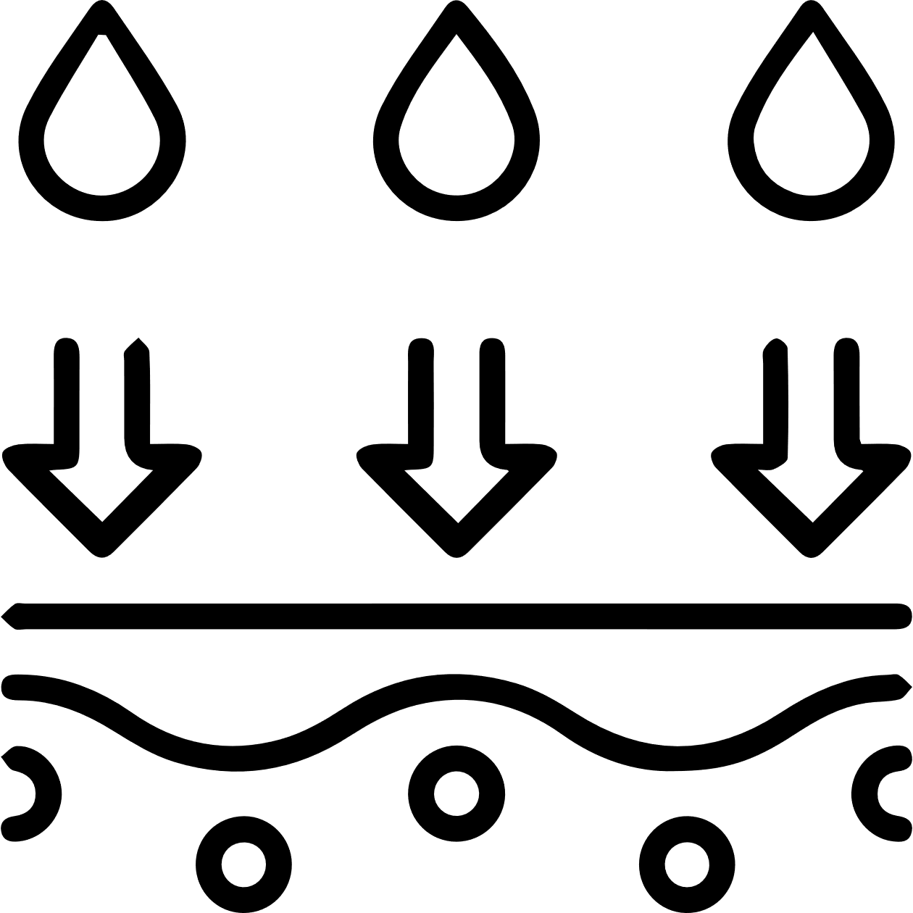


What are the benefits of INDIBA in body tightening?
More collagen & elastin
Better skin oxygenation
Hydrates the skin
Healthier & stronger tissues
Safe & Pleasant
Non - invasive
Non - ablative

Slide 6


What happens during an INDIBA treatment?
You will lie on a comfortable treatment bed
The operator will ask you to remove all your make-up and jewelry
Special treatment cream will be applied over the target area
You will then receive a relaxing massage with the electrode for approximately 30-60 minutes (depending on the target area)
During the treatment you will feel a pleasant heat sensation
The treatments produces zero side effects, and requires no downtime
After the treatment has finished, you will be able to get up from the treatment bed and continue with your day
Your therapist will inform you about the desirable number of sessions to achieve your goal

Slide 7












Media Mentions

Slide 8





TESTIMONIAL
Celebrities that love INDIBA
“How to end a long day so that your skin is 100%? #INDIBA
“And to end the day, 30 minutes of INDIBA”
Helen Lindes (Miss Spain 2000)
María Pombo (Spanish influencer)

Slide 9









TESTIMONIAL
Celebrities that love INDIBA
Kate Winslet. Oscar Best Actress
Julianne Moore. Oscar Best Actress
Paula Echevarria. Spanish Actress
Toni Garrn Supermodel
Rhianna Singer
Rocío Osorno Fashion Designer

Slide 10

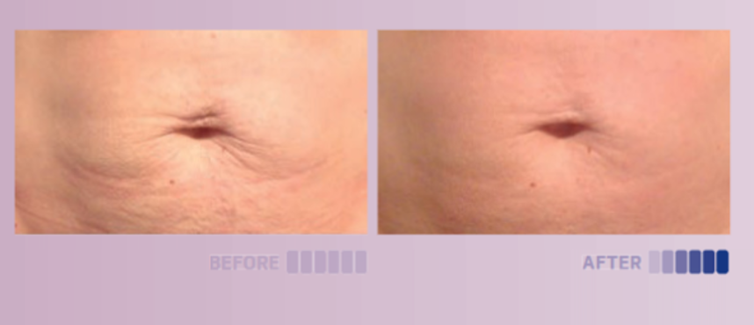
Before & After
1 session
Courtesy of: María Brau Centro Wellness (Spain)

Slide 11

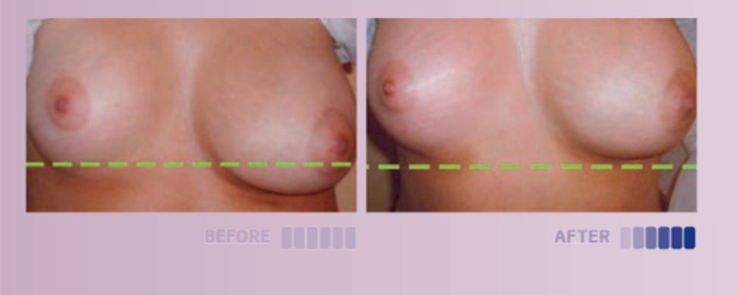

Before & After
5 sessions
Courtesy of: Benessere (Argentina)

Slide 12
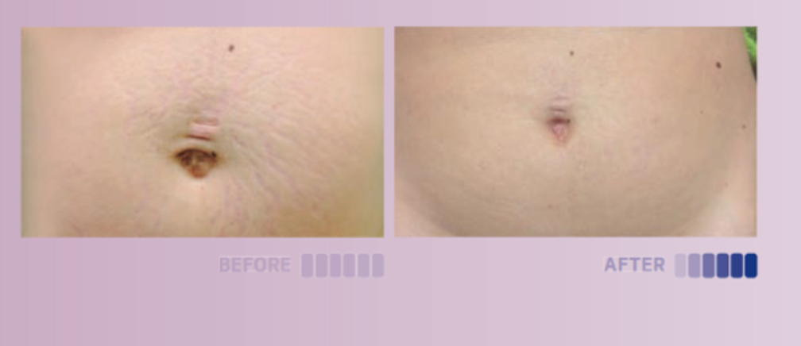
Before & After
10 sessions
Courtesy of: Origen Estética (Spain)

Slide 13
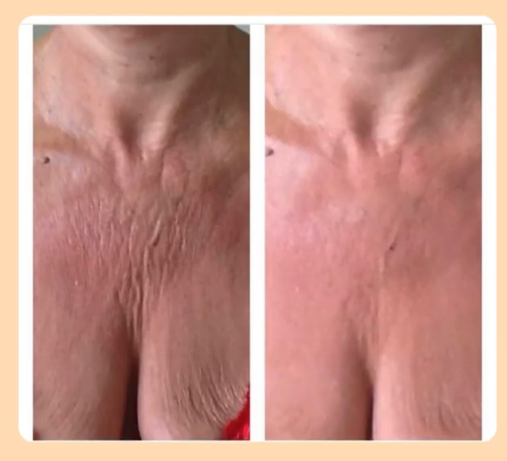
Before & After
3 sessions
Courtesy of: INDIBA France

Slide 14
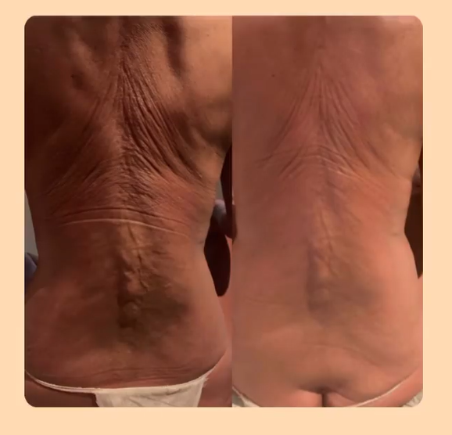

RESULT
Before & After
12 sessions
Courtesy of: INDIBA France

Slide 15
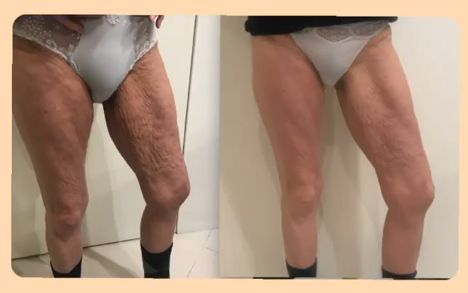

RESULT
Before & After
12 sessions
Courtesy of: INDIBA France

